Slide 1

Grocery Store Management
Presented By:- Shinde Pranali

Slide 2
About me
I am Pranali Shinde . I Recently completed BBA(CA),from Savitribai Phule Pune University.
I want to learn Data Science because I am interested in working with data, learning new technologies, and building a strong career in this field.
I am Fresher.
My LinkedIn profile:- [https://www.linkedin.com/in/pranali-shinde-03679231a]
My GitHub profile: -[https://github.com/PranaliShinde09]

Slide 3
Objective
The main objective of the Grocery Store Management is to manage daily store operations easily and efficiently.
It helps in maintaining records of products, customers, sales, and billing in a systematic way.
The system reduces manual work, saves time, avoids errors, and makes the store management process faster and more accurate.

Slide 4
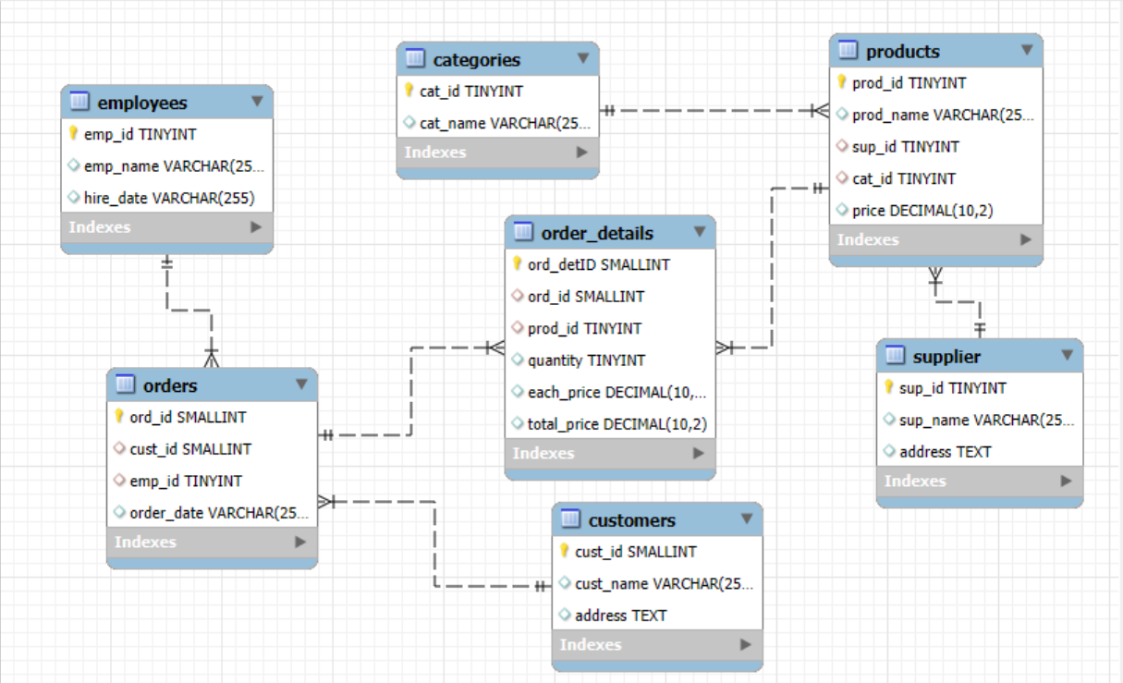
E-R Diagram

Slide 5
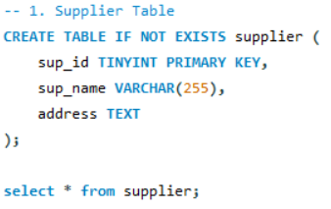
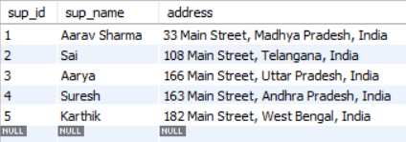
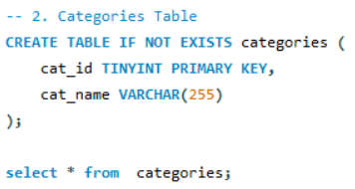
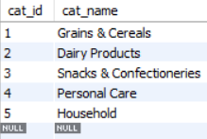
Tables

Slide 6
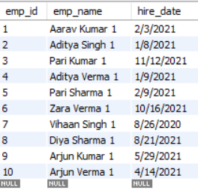
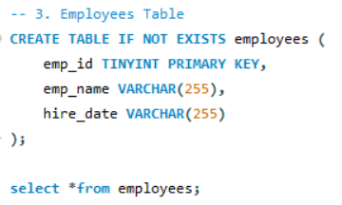
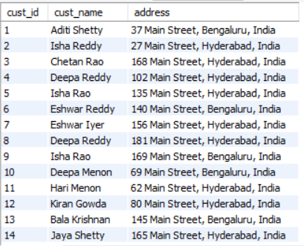
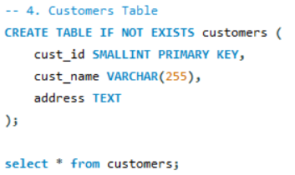

Slide 7
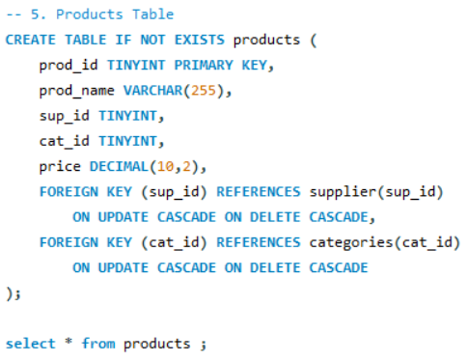
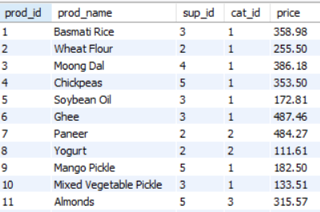

Slide 8
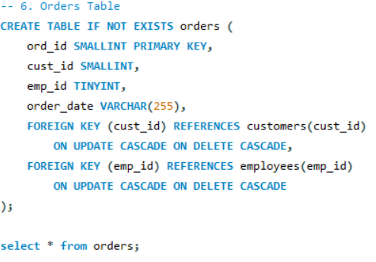
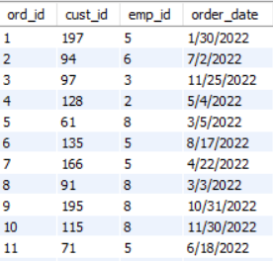

Slide 9
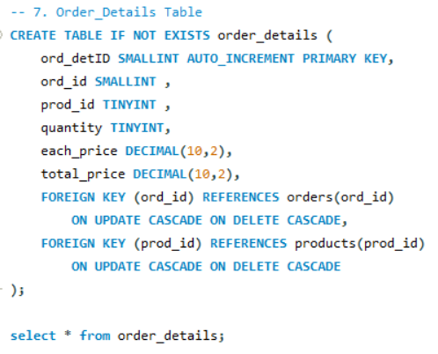
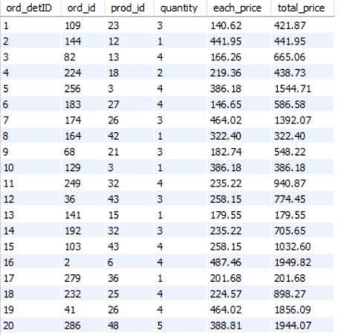

Slide 10
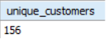
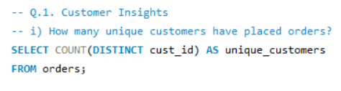
SQL Query
i) How many unique customers have placed orders?

Slide 11
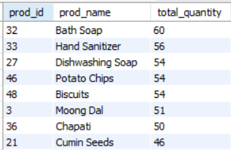
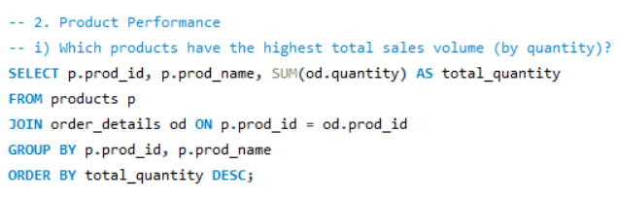
ii) Which products have the highest total sales volume (by quantity)?

Slide 12
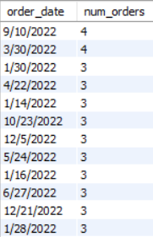
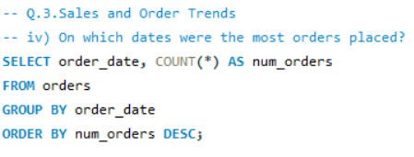
iii) On which dates were the most orders placed?

Slide 13
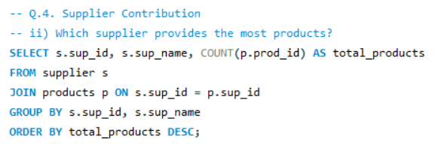
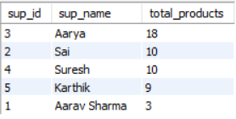
iv) Which supplier provides the most products?

Slide 14
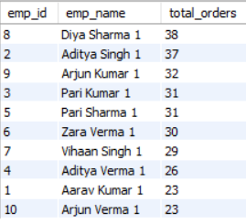
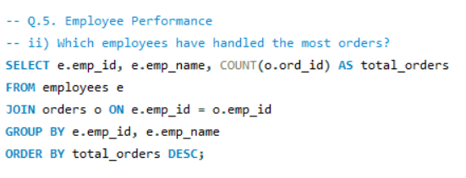
v) Which employees have handled the most orders?

Slide 15
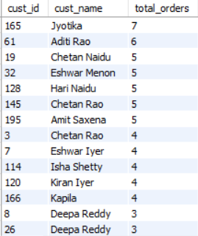
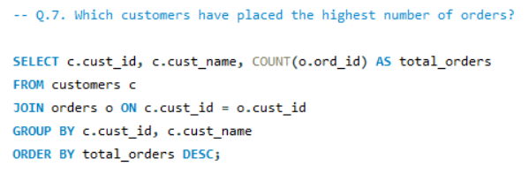
vi) Which customers have placed the highest number of orders?

Slide 16
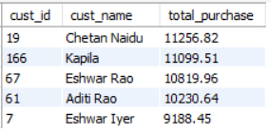
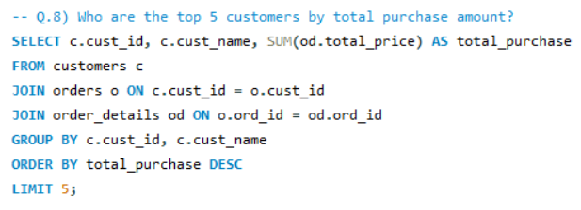
vii) Who are the top 5 customers by total purchase amount?

Slide 17
Business Insights
1.The system helps keep proper record of products and reduces wastage.
2.It shows which items sell fast and which items sell slowly.
3.Customer details help to understand what people buy more.
4.Billing becomes quick, clear, and without mistakes.

Slide 18
Challenges
1.Complex SQL queries:-
Writing queries with multiple joins, window functions was challenging.
It required careful structuring and testing to get correct results
2.Understanding relationship between tables :-
to understanding the relationship between tables are time consuming

Slide 19
Conclusion
The Grocery Store Management System makes store work easy and systematic.
It saves time, reduces mistakes, and helps in better product, sales, and customer management.
Overall, it improves the efficiency of the store.

Slide 20

THANK YOU

